Slide 1
Classification of phishing websites
The Impact of Feature Selection

Slide 2
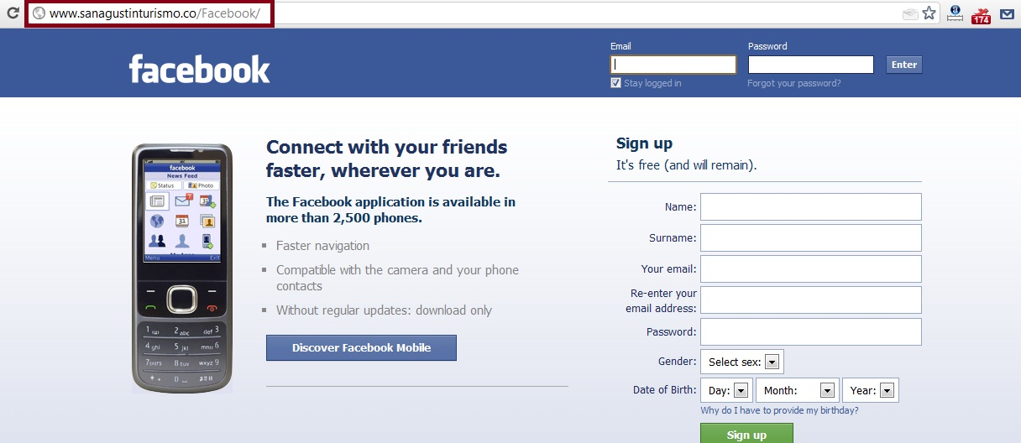
What is a phishing website?

Slide 4
Notes:
Feature #8: Uses HTTPS and Certificate > 1 Year
Feature #14: % difference of URL of Anchor
Feature #7: Number of dots (excluding www. and .com)
Feature #13: Request URL

Slide 6
Notes:
DT is using the feature set selected from SVM results

Slide 7
Different classification methods Prefer different features
Naïve Bayes
SVM
Feature #8: SSL Final State
Feature #14: URL of Anchor
Feature #6: Prefix/Suffix
Feature #15: Links in Tags
Feature #2: URL Length
Feature#7: Sub Domain
Feature #8: SSL Final State
Feature #14: URL of Anchor
Feature #6: Prefix/Suffix
Feature #1: IP Address
Feature #13: Request URL
Feature #22: Popup Window

